Slide 1

Lecture #1
Introduction
From High-Level Languages to Computer Organisation
(AY2022/23 Semester 1)

Slide 2
Question and Answer
Q&A QR code appears at the bottom left corner of the screen.
QR code may be obscured in some slides.
Also accessible at: https://app.sli.do/event/qVCWNryB45Bnh6p2HRfnFG
Q&A link closes after the recitation.
Questions will be answered during the recitation.
You may post additional questions during the recitation:
If we are unable an answer a question during the recitation, we will do so on the Canvas forum.

Slide 3
Blended Learning Format
New format that we are piloting this semester.
Lecture slides and videos will be uploaded in advance.
We meet every Tuesday face-to-face and over Zoom (hybrid) to answer your questions and do additional exercises.
First meeting on 16 August 2022.
4 pm to 6 pm, I3-Auditorium. Pre-registration required due to limited space.
Alternatively, attend online at:
https://nus-sg.zoom.us/j/89293172156?pwd=unlNkJJJnF8VS6NfqaN6HUOD9Ihr5.1
Meeting ID: 892 9317 2156
Passcode: 949665

Slide 4
Blended Learning Format
New format that we are piloting this semester.
Lecture slides and videos will be uploaded in advance.
We meet every Tuesday face-to-face and over Zoom (hybrid) to answer your questions and do additional exercises.
You MUST read the slides and watch the videos in advance.
There will be 5 to 8 questions during the lectures for you to answer. Submissions close on Tuesday morning.
Totals 5% of your course grade.
What will we do on Tuesdays?
Answer questions on the Q&A.
Extra exercises to help you understand the materials better.

Slide 5
Lecture #1: Introduction
Programming Languages
C Programming Language
Abstraction
So, What is a Computer?
Why Study Computer Organisation?

Slide 6
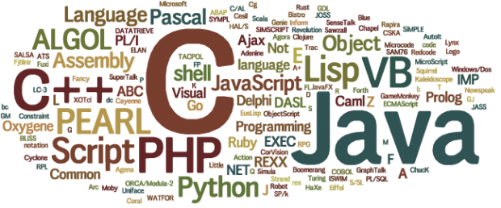
1. Programming Languages
Programming language: a formal language that specifies a set of instructions for a computer to implement specific algorithms to solve problems.

Slide 7
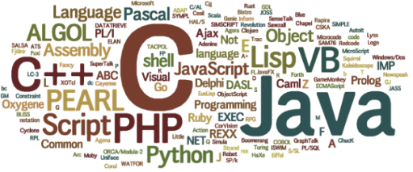
1. Programming Languages
High-level program
Eg: C (CS1010), Java (CS1010J), Python (CS1010S), ECMAScript (CS1101S)
int i, a = 0;
for (i=1; i<=10; i++) {
a = a + i*i;
}
a = 0
for i in range(1,11):
a = a + i*i
addi $t1, $zero, 10
add $t1, $t1, $t1
addi $t2, $zero, 10
Loop: addi $t2, $t2, 10
addi $t1, $t1, -1
beq $t1, $zero, Loop
Low-level program
Eg: MIPS (CS2100)
Machine code
00100000000010010000000000001010
00000001001010010100100000100000
. . .
Computers can execute only machine code directly.

Slide 8
1. Programming Languages (3/5)
1st Generation Languages
2nd Generation Languages
3rd Generation Languages
4th Generation Languages
5th Generation Languages
Machine language.
Directly executable by machine.
Machine dependent.
Efficient code but difficult to write.
Assembly language.
Need to be translated (assembled) into machine code for execution.
Efficient code, easier to write than machine code.
Closer to English.
Need to be translated (compiled or interpreted) into machine code for execution.
Eg: FORTRAN, COBOL, C, BASIC
Require fewer instructions than 3GL.
Used with databases (query languages, report generators, forms designers)
Eg: SQL, PostScript, Mathematica
Used mainly in A.I. research.
Declarative languages
Functional languages (eg: Lisp, Scheme, SML)
Logic programming (eg: Prolog)

Slide 9
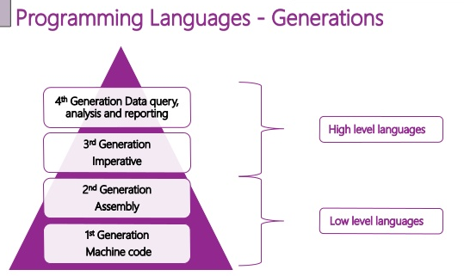
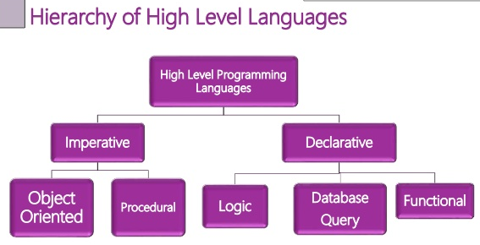
1. Programming Languages (4/5)
“Generational” classification of high level languages (3GL and later) was never fully precise.
A different classification is based on paradigm.

Slide 10
1. Programming Languages (5/5)
Difference between scripting languages and programming languages
Scripting languages | Programming languages
Eg: JavaScript, PHP, Python | Eg: C, C++, Java
Interpreted; do not require compilation | Compiled
Generally slower | Generally faster
However, the environment is more important than the language in the classification.
We can write a C interpreter and use it as a scripting language
We can compile JavaScript to machine code
The distinction is getting blurred due to improved hardware capabilities and coding practices
Eg: Python is widely used without compilation, but the main implementation (CPython) does that by compiling to bytecode on-the-fly and then running the bytecode in a VM (virtual machine)
Eg: Java is compiled to bytecode, which is then interpreted/recompiled at runtime

Slide 11

2. C Programming Language (1/4)
Created by Dennis Ritchie (1941 – 2011) at Bell Laboratories in the early 1970s.
C is an imperative procedural language.
C provides constructs that map efficiently to typical machine instructions.
C is a high-level language very close to the machine level, hence sometimes it is called “mid-level”.
UNIX is written in C.
HelloWorld.c
#include <stdio.h>
int main(void) {
printf("Hello, world\n");
return 0;
}
HelloWorld.py
print("Hello, world")
(Note: All C programs in the lectures are available on LumiNUS as well as the CS2100 website. Python versions are also available.)
Notes:
An imperative language uses a sequence of statements to determine how to reach a certain goal. These statements are said to change the state of the program as each one is executed in turn.
A procedural language is a type of computer programming language that specifies a series of well-structured steps and procedures within its programming context to compose a program. It contains a systematic order of statements, functions and commands to complete a computational task or program.

Slide 12
2. C Programming Language (2/4)
Creating a C program
Editor
Source code
Compiler
Object code
Other object codes
Function libraries
Linker
Executable code

Slide 13
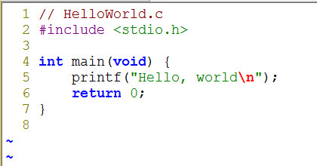
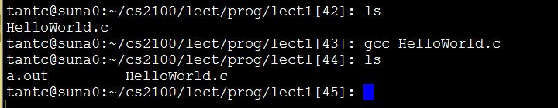

2. C Programming Language (3/4)
Edit
Illustration on SoC UNIX server
Compile and link
Execute

Slide 14
2. C Programming Language (4/4)
Compile and link
The command gcc hides all the details
Using gcc –v HelloWorld.c will display all the details
The process goes through the following steps to generate machine code:
Preprocessing
Compilation
Assembler
Linker

Slide 15
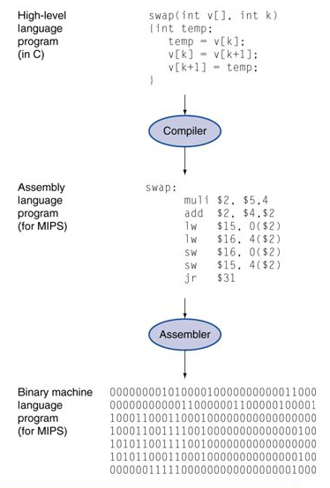
3. Abstraction (1/3)
High-level language
Level of abstraction closer to problem domain
Provides productivity and portability
Assembly language
Textual and symbolic representation of instructions
Machine code (object code or binary)
Binary bits of instructions and data

Slide 16
3. Abstraction Layers (2/3)
Hardware/Software Stack in Computer
CS4212
Application software
CS2106
Compiler
Software
Assembler
Operating System
Linker
Loader
Scheduler
Device Drivers
Instruction Set Architecture (ISA)
Processor
Memory
I/O System
Datapath & Control Design
Hardware
Digital Logic Design
CS2100
Circuit Design
Transistors

Slide 17
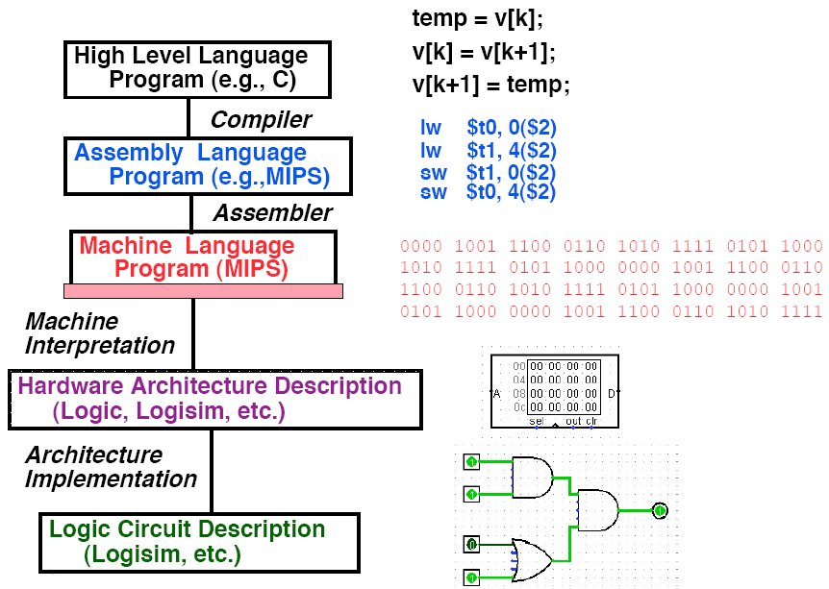
3. Abstraction (3/3)
Level of Representation

Slide 18
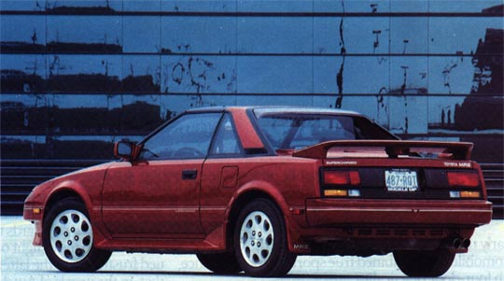

4. So, What is a Computer? (1/6)
Driver
Example: An automobile augments our power of locomotion.
A computer is a device capable of solving problems according to designed programs. It simply augments our power of storage and speed of calculation.
Programmer

Slide 19
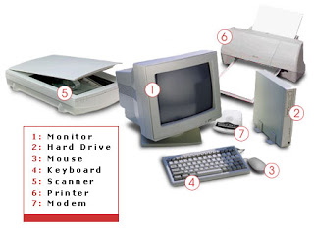
4. So, What is a Computer? (2/6)
From computer organisation perspective, we study the components and how they work together
Processor, memory, input/output devices, networks, …
Credit: http://tech4abc.blogspot.sg/2010/08/latest-technology-in-computer-hardwares.html

Slide 20

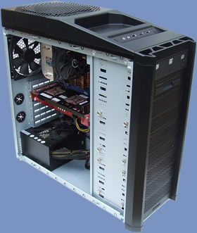
4. So, What is a Computer? (3/6)
Power supply
Motherboard
Central Processing Unit (CPU)
Random Access Memory (RAM)
Hard drive
Cooling fan
I/O devices
Credit: http://www.overclock3d.net/reviews/cpu_mainboard/the_computer_council_-_clocked_gamer_quad/1
Credit: http://tech3news.com/most-recent-computer-technology/

Slide 21
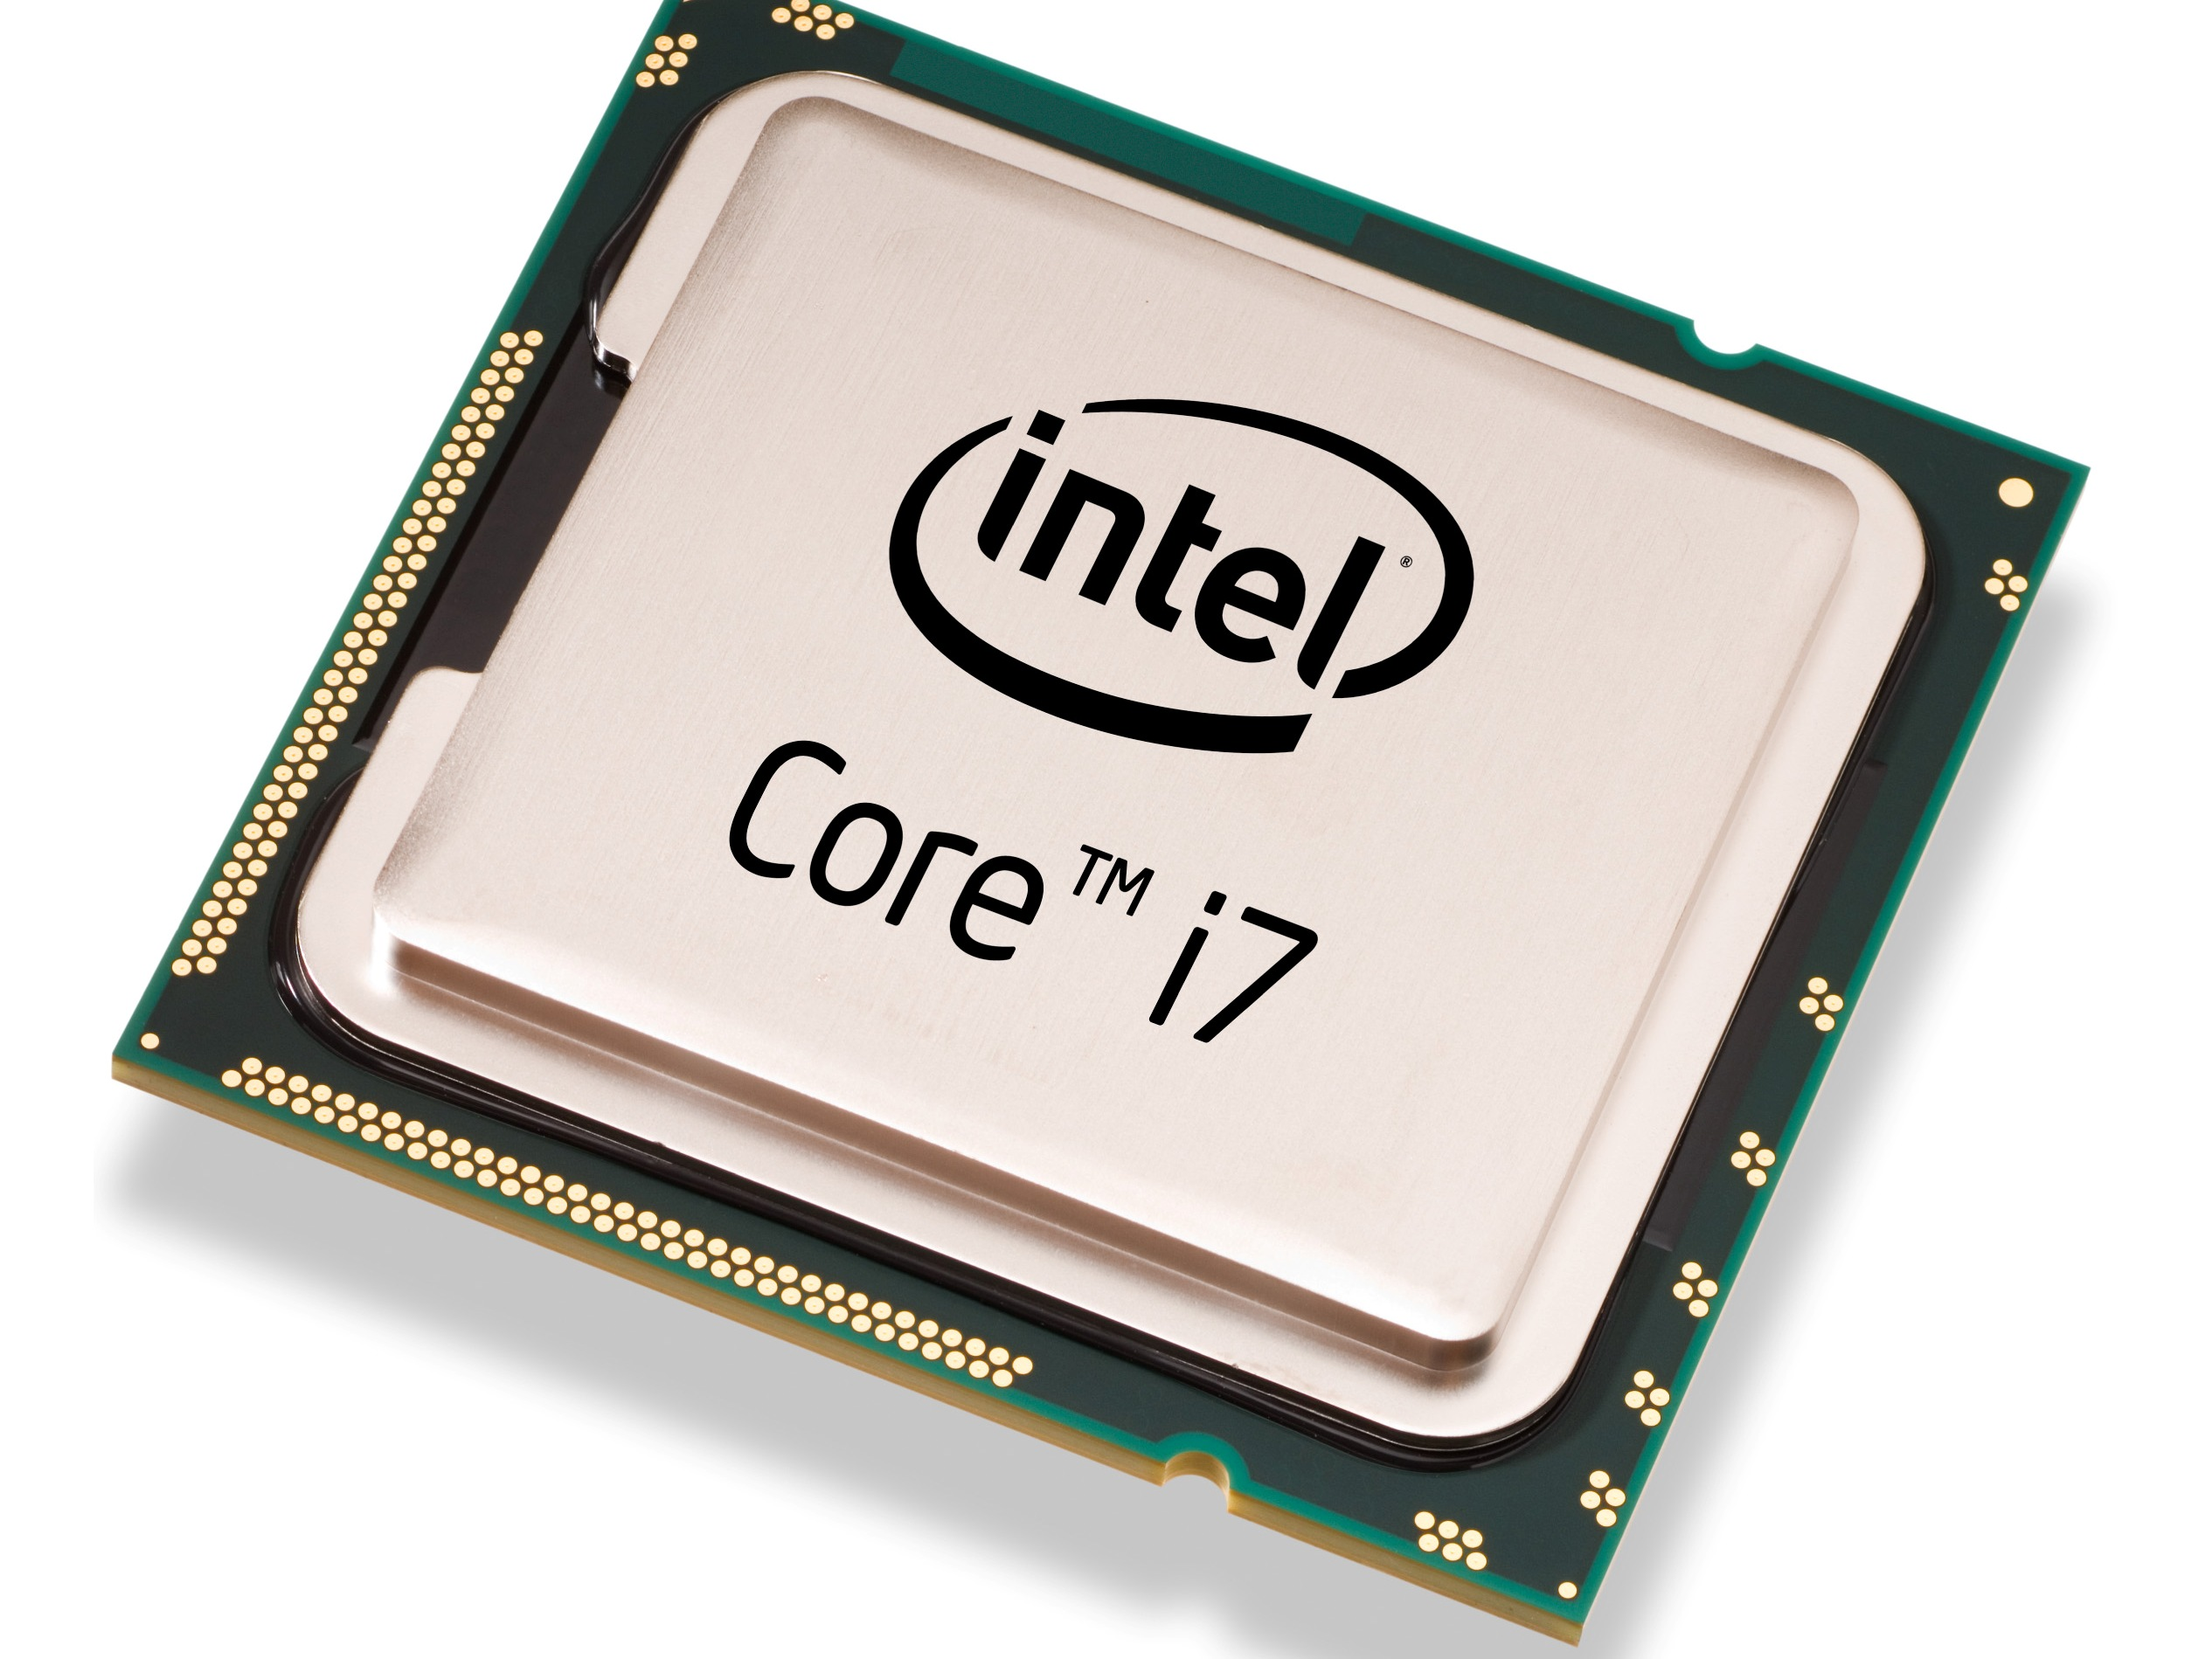
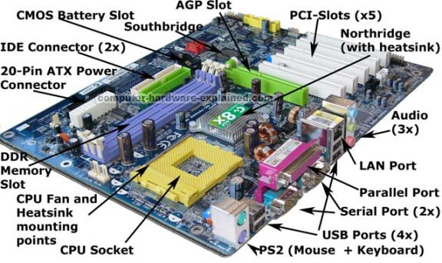
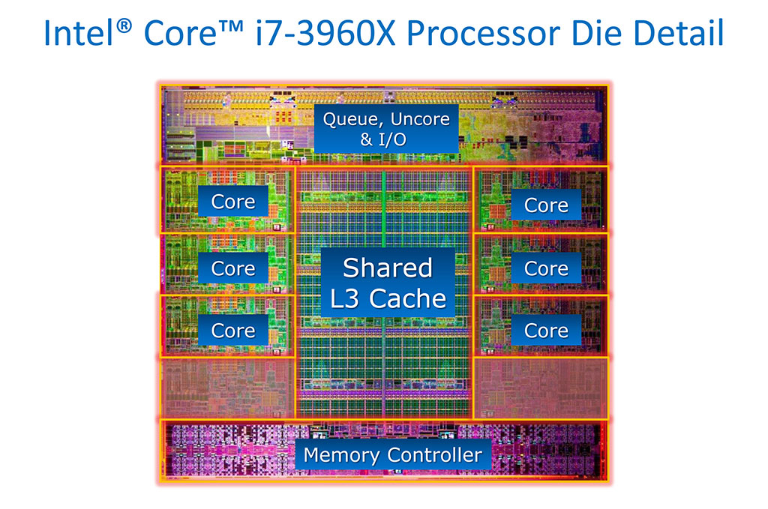
4. So, What is a Computer? (4/6)
PC motherboard
Intel i7 Processor
Credit: http://www.computer-hardware-explained.com/what-is-a-motherboard.html

Slide 22
4. So, What is a Computer? (5/6)
Central Processing Unit
(CPU)
Control Unit
Input Device
Output Device
ALU
Memory Unit
ALU: Arithmetic/Logic Unit

Slide 23



4. So, What is a Computer? (6/6)
Next generation…
Credit: http://www.custom-build-computers.com/Latest-Computer-Hardware.html
Credit:
http://www.prabhanjamindiaits.com/blogdetailedpage.aspx?id=66
Credit: http://new-techpc.blogspot.sg/2012/10/latest-in-computer-technology.html

Slide 24
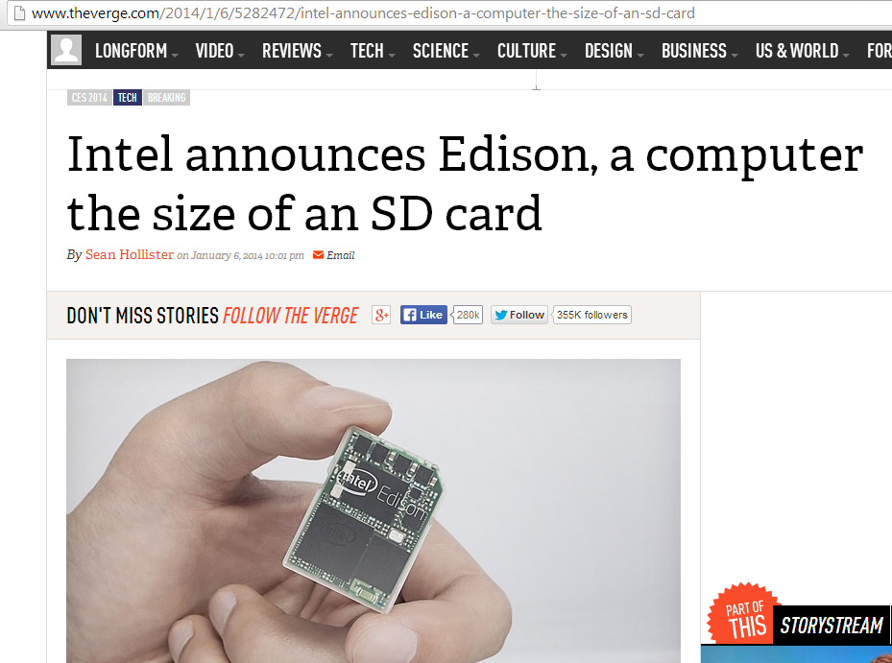
6th January 2014
http://www.theverge.com/2014/1/6/5282472/intel-announces-edison-a-computer-the-size-of-an-sd-card

Slide 25
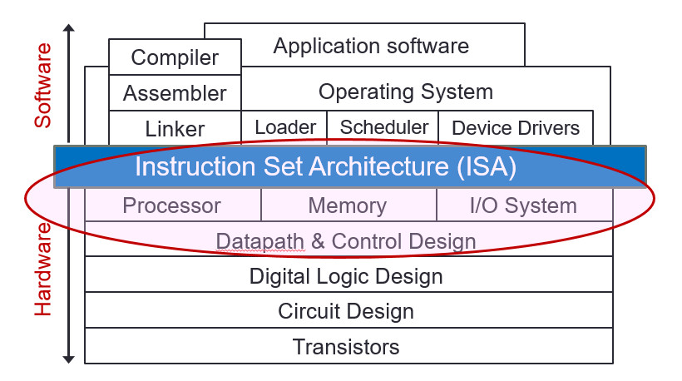
5. Why Study Computer Organisation?
Computer organisation is the study of internal working, structuring and implementation of a computer system.
It refers to the level of abstraction above the digital logic level, but below the operating system level.
CS2100

Slide 26
5. Why Study Computer Organisation?
(From user to builder)
You want to call yourself a computer scientist/specialist.
You want to build software people use.
You need to make purchasing decisions.
You need to offer “expert” advice.
Hardware and software affect performance
Algorithm determines number of source-level statements (eg: CS1010, CS2030, CS2040, CS3230)
Language, compiler, and architecture determine machine instructions (COD chapters 2 and 3)
Processor and memory determine how fast instructions are executed (COD chapters 5, 6 and 7)
Understanding performance (COD chapter 4)

Slide 27
End of File

